Slide 1
JUJA CLASSIFIEDS GROUP 4
Sharon Opondo
Annette Irungu
Amos Mbeki
Elijah Kyule
Kennedy Muia

Slide 2
Problem Statement and Justification
Juja Classifieds provides a standard platform for buying and selling transactions for Juja residents. The site requires user registration before an individual can access the items available or add anything to the website. The items on sale are divided into 4 categories, from which the user can filter objects based on multiple criteria.
We hope to eliminate the use of paper as an advertisement mode, especially in JKUAT, as paper is harmful to the environment.
The site’s value will be derived from its practicality, functionality and the contributions from its users.

Slide 3
Programming Languages and Frameworks Used
HTML5 & CSS
BootStrap
PostgreSQL
Python Django

Slide 4
Methodology Used: Waterfall Model
The website development took place in phases. The results the members of the development team obtain in each stage were used as the input in the next phase. The user requirements were not expected to change. Each of the technological aspects to be used was well-understood.

Slide 5

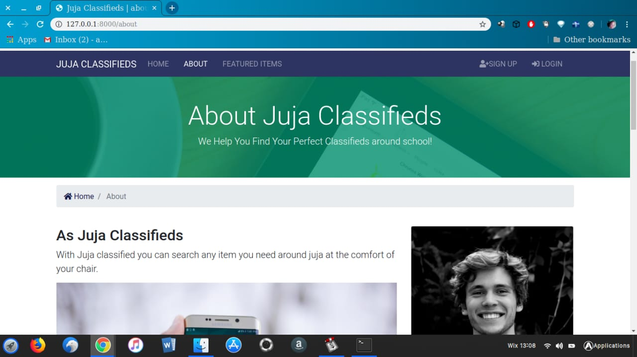

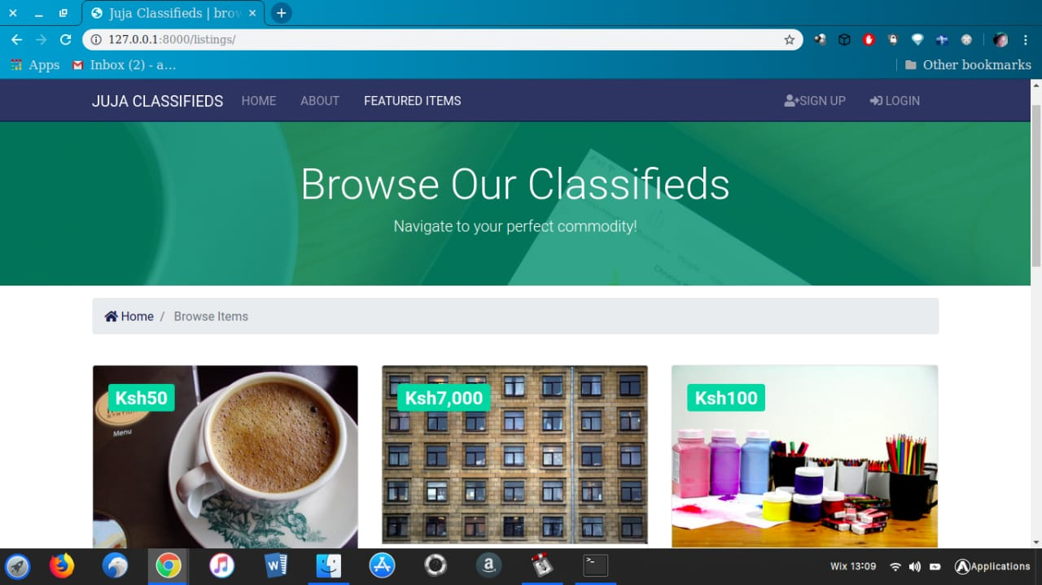
Welcome to Juja Classifieds!
Like popular online marketplaces such as eBay, Juja Classifieds will use a log-in system to identify users and ensure they conduct activities securely. The use of sessions will offer a chance for secure interactions and transaction executions between sellers and buyers without compromising information security. For instance, the seller’s telephone numbers will only be displayed once a potential buyer confirms their interest in the seller’s product.

Slide 6
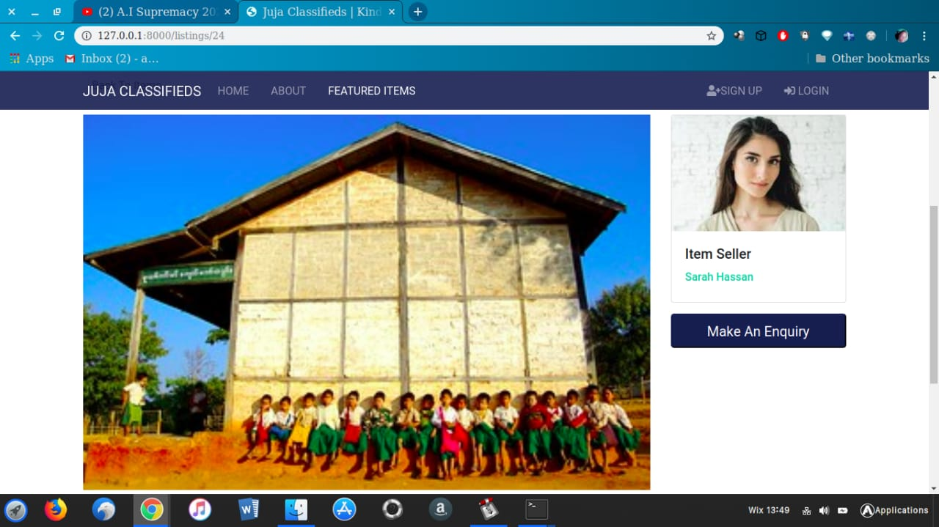

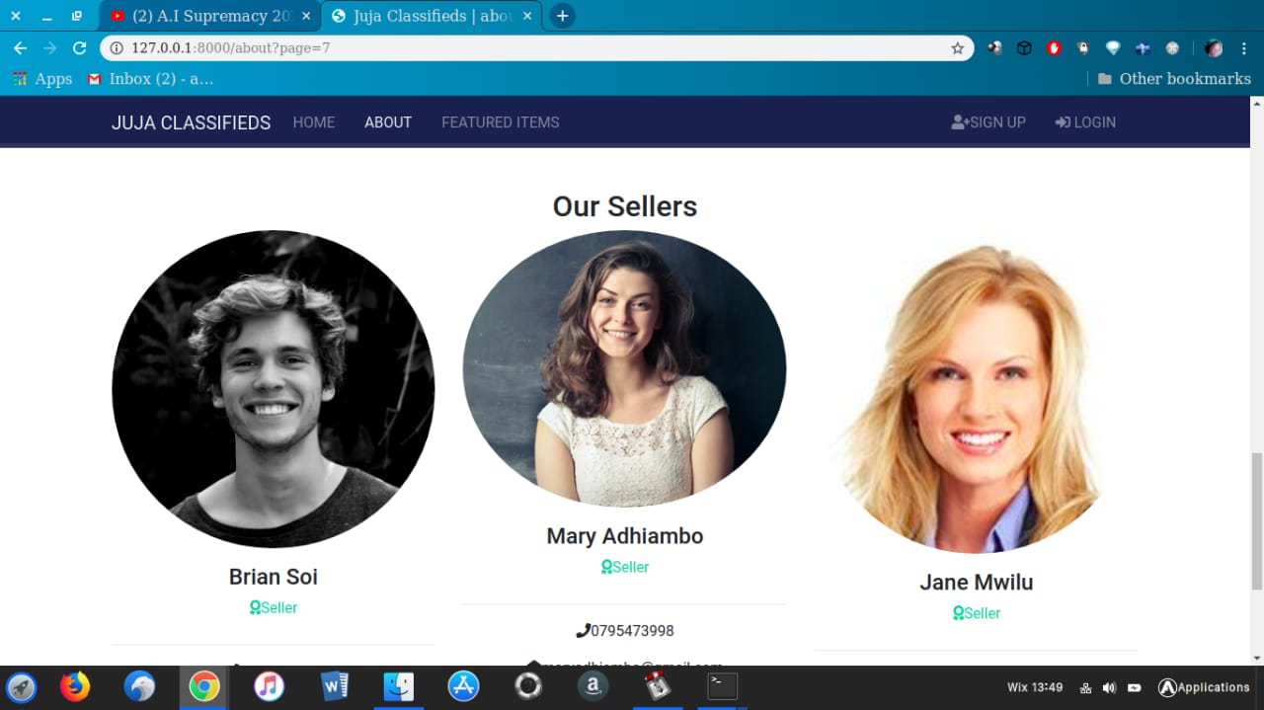


Juja Classifieds
Juja Classifieds
Users can also filter search results to suit their specific needs.
Sellers can also edit their product details and add on to their advert posts.

Slide 7
Sponsors
Companies affiliated with students, such as hostels and eateries around Juja.
Pop-up Advertisements
Ads featuring student-centered services, such as banks, electronic shops, and betting sites.
Transaction Fee
Sellers wishing to register as administrators so they can edit their content will be required to pay a minimal service fee.
Monetization Efforts

Slide 8
Recommendations for Future Development Activities: Host the website so it is available to more users. Advertise the site to gain enough traction to enable Juja Classifieds to become a permanent fixture. Ensure continued maintenance for optimum operation.

Slide 9
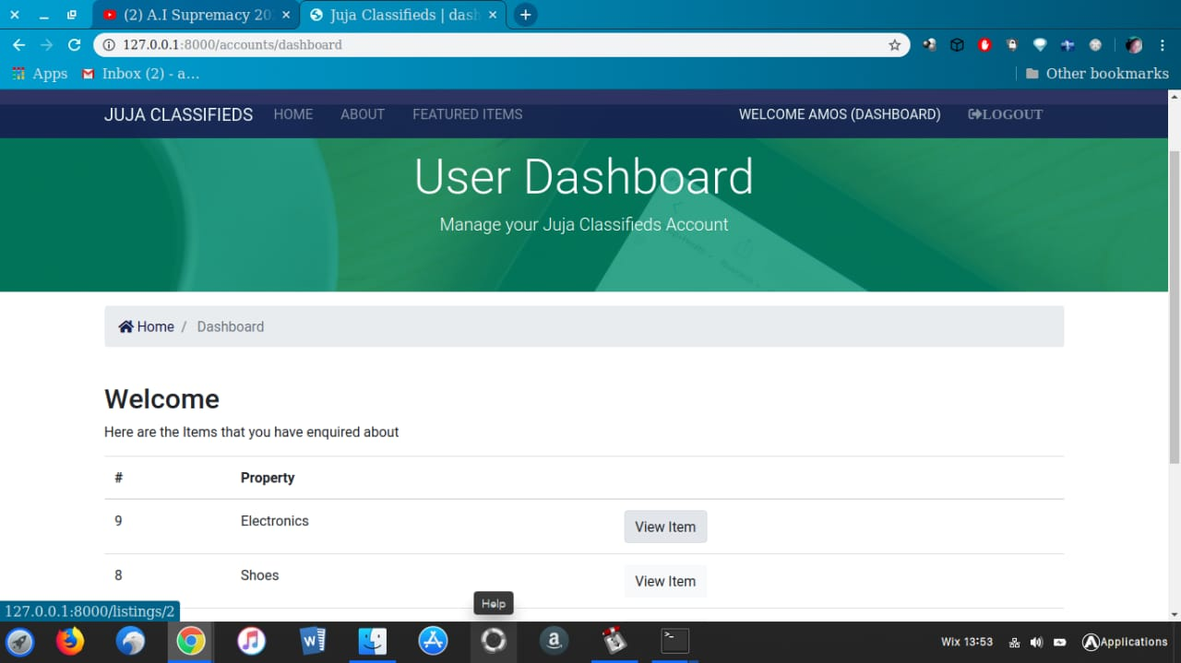
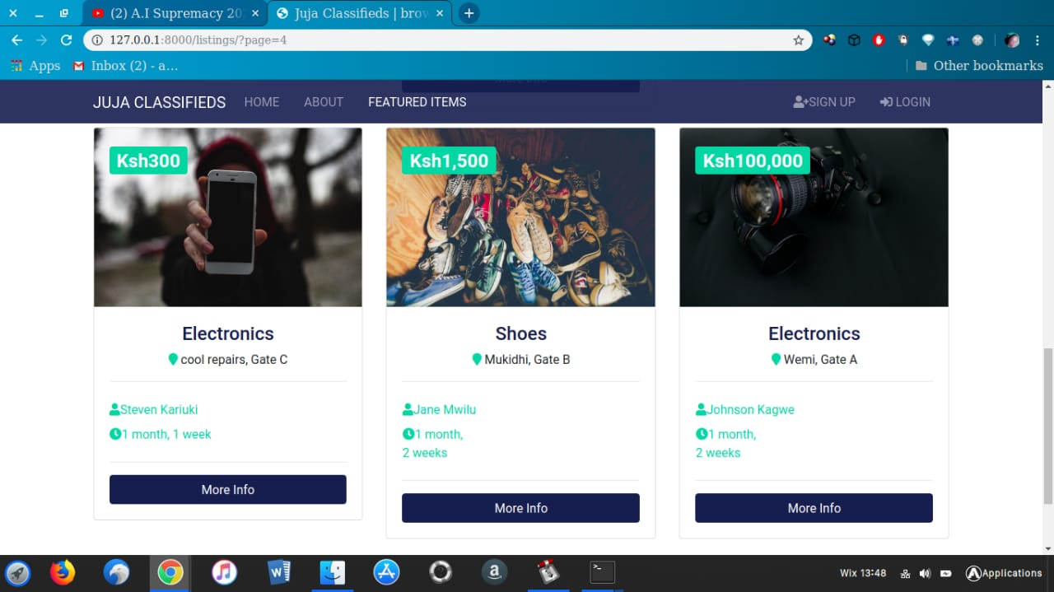
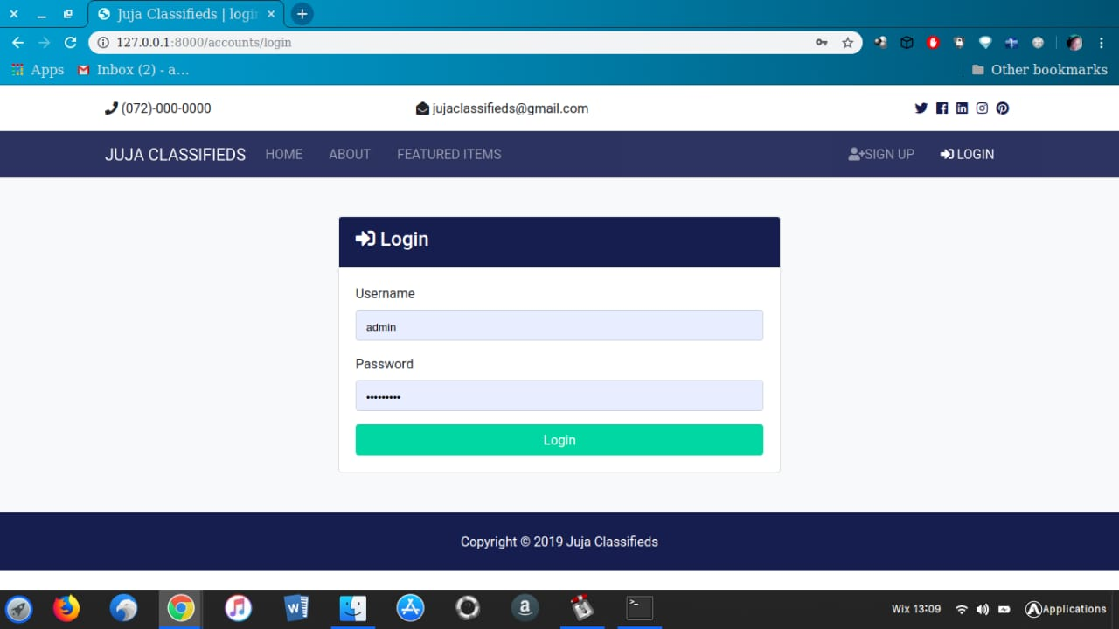

Slide 10

Thank you!

